Slide 1

Theme - Mapping Data for Societal Benefit
Project Name – Environment Performance Indicators
Built By
Tanay Mathur
Mehek Mathur
Prabhu RC
Ruchir Mathur (Team lead)

Slide 2
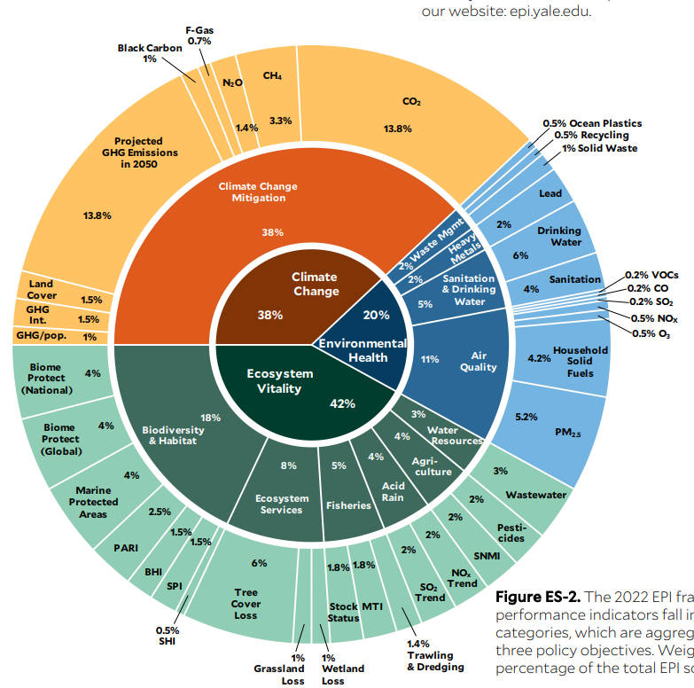
Problem Statement & Objectives
Problem Statement - Build an Environment Data platform that uses NASA data and create a web app that uses the Environment data platform data. We plan to use the Environment Performance data index from NASA for this project.
Environment Performance Index
What is Environment Performance Index and why is it important ?
Environment Performance index provides data that gauges countries on Environment performance
It Ranks 180 countries on 40 environment performance indicators
It ensures that there is governance on the Environment Goals that countries have set up
Detailed performance indicators ensures that there is traction at each level
Country wise data helps governments formulate environment policy
Detailed information available at state, county and city level help curate solutions that are specific for a particular geography and demographic

Slide 3
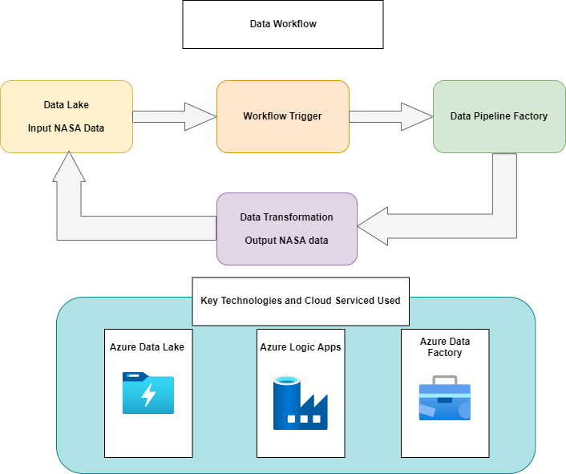
Environment Data Platform Architecture
Key Highlights
NASA Data in the form of CSV file gets loaded into Azure Data Lake.
Azure Logic Data Apps checks the availability of the file and triggers the Azure Data Pipeline.
Azure Data Pipeline Transforms the Data into JSON.
Azure Data Factory outputs the data and stores into Azure Data Lake as JSON.
Apps can access JSON data as an API and use it.

Slide 4
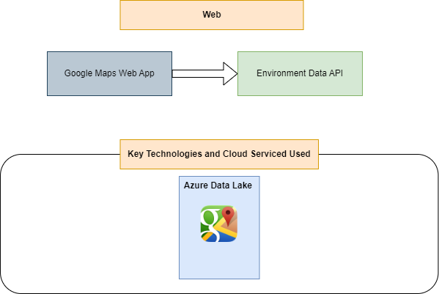
Web App Architecture
Key Highlights
Web app shows the Environment Data on Google Maps
Data from the Environment Data Platform gets fed into the web app
Google Maps app creates environment based charts and shows it on the map
Google Map app uses JSON data from the Azure Data Lake API
This data can then be used to draw inferences on climate data

Slide 5
Key Benefits of the Solution
One Stop Solution for Environment data needs
Unified Environment Data Platform
Easy Environment Data Loads
Intuitive User Interface for showing environment data
Simple User Interface
Detailed Environment Information available
Data available at one place
Detailed recommendations to solve the climate change challenges
Rich Map and Chart features
Advanced Analytics possible on the data

Slide 6
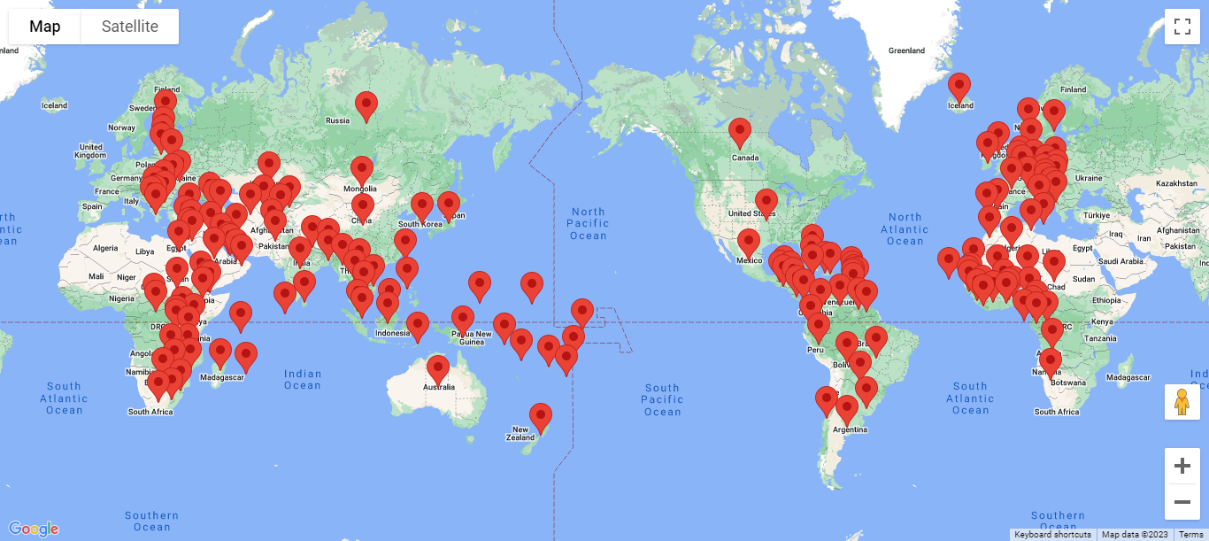
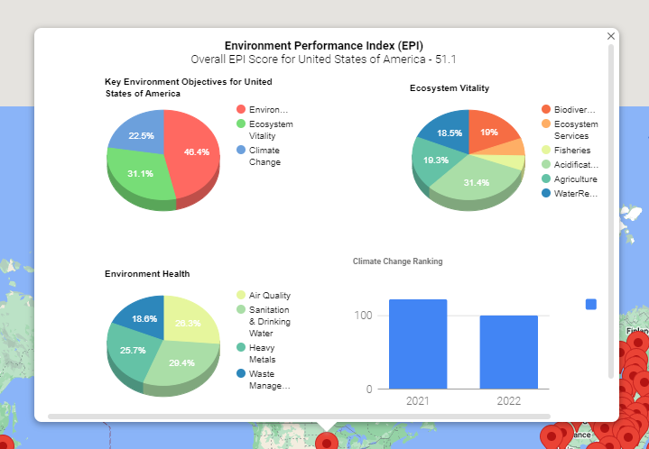
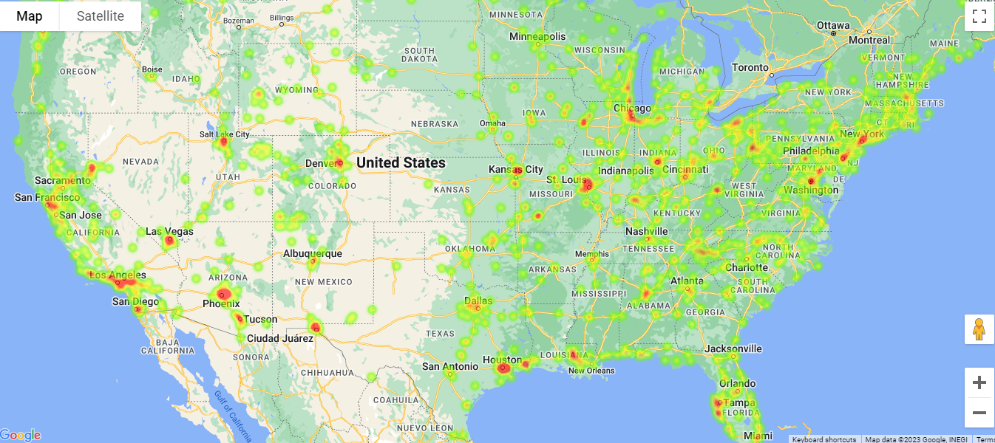
Environment Performance Index Maps
Global Map showing country specific Pins, users can click to get detailed information
Key EPI Indictors shown after clicking the Pins on the Map
Heatmap of Air Quality Index in the US after clicking on “Air Quality” index

Slide 7
Next Steps & References
Mapping Data for Societal Benefit
Keep Building the Platform and spread the word
Expand the Environment Data Platform and add additional information on it.
Make this platform as Unified Platform that common people can use and get environment and climate change information from
Build Maps for additional environment parameters
Make the Environment Platform API's accessible for developers to use
Integrate a recommendations feature to provide information to users to solve climate change issues
References
NASA - Environment performance index
EPA - Pre Generated AIR quality files
EPA - NASA air quality
EPA - Water Quality
EPA - Water Quality Portal
NRDC - Causes of Climate change
EPA - Causes of climate change
United Nations - Climate Change
Research Data
NASA - Climate Change

